Slide 1
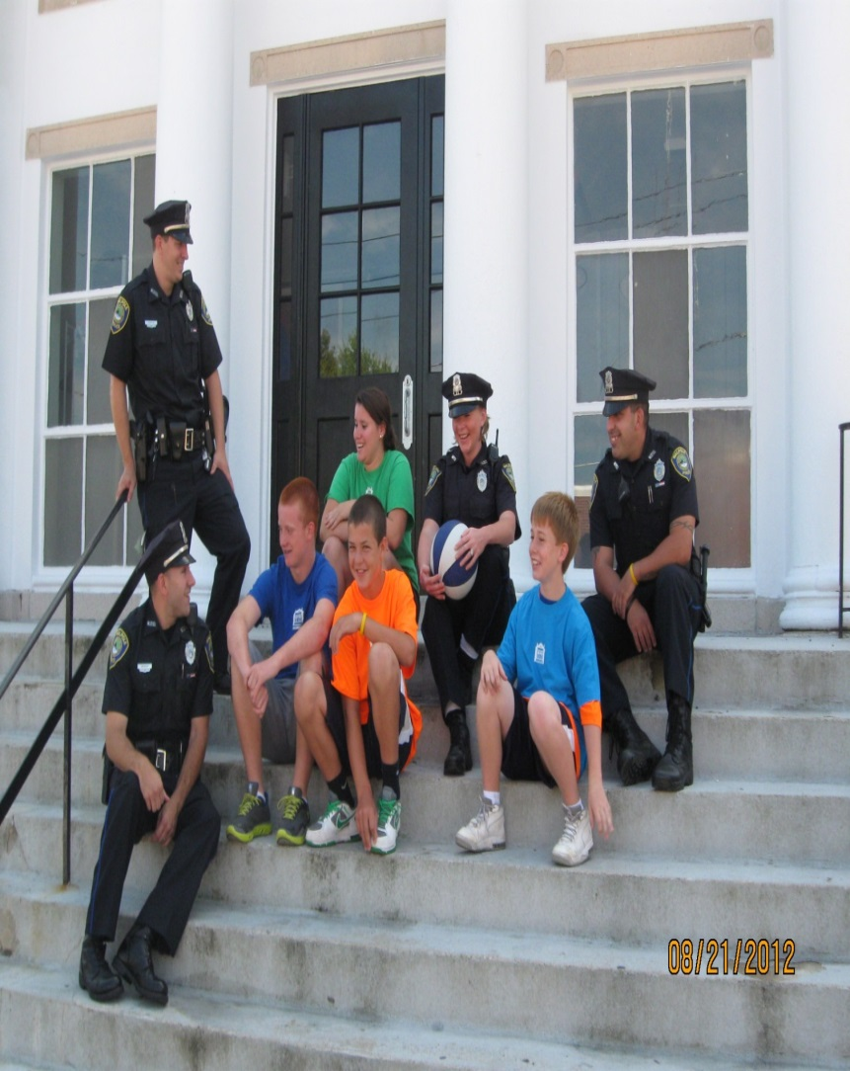

WALPOLE DRUGS -101

Slide 2
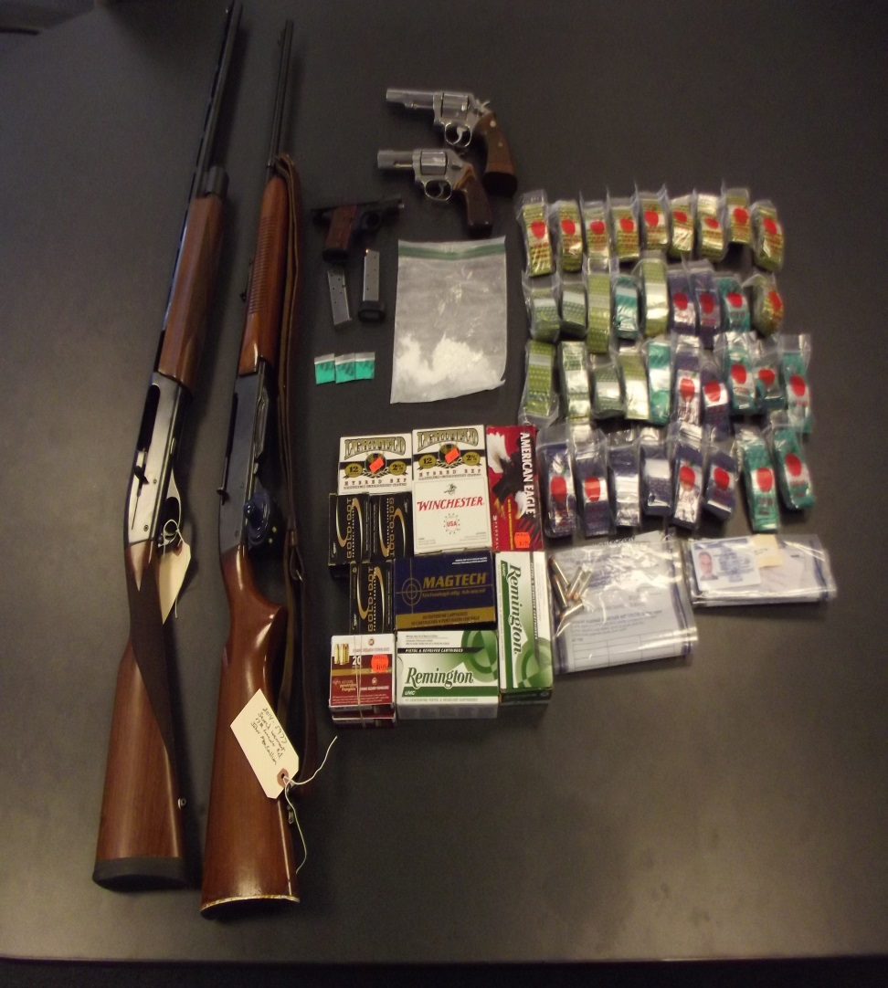
Drugs
How Do We Measure the Problem?
Surveys: Youth Risk Behavior Survey & the WPD Citizen Survey.
Intelligence: Cultivating and Developing Confidential Informants. (drug trends, pricing, packaging, availability, delivery, how it is used)
Investigations: Multi-jurisdictional Regional Task Force, Norfolk County Police Anti-Crime Task Force (NORPAC). Infiltrates the drug trafficking organizations (DTO) through CI and UC. Work with local, state, federal agencies.
Partnership: BPD DCU, State, DEA.
Arrests: Persons arrested, encountered-FIO, interdiction.
Debriefing: First hand information regarding drug trade, following arrest.
Health/Wellness: WPD responds to all matters involving sudden death, suicide, overdose poisonings, warrants of apprehension. Reactive capacity and establish first hand observation.
Ancillary Crimes: Robbery, shoplifting, B&E, larceny, pawn, baby formula theft, prescription drug theft – fueling drug habits.
Drug Treatment Episodes, Parent Notifications,

Slide 3
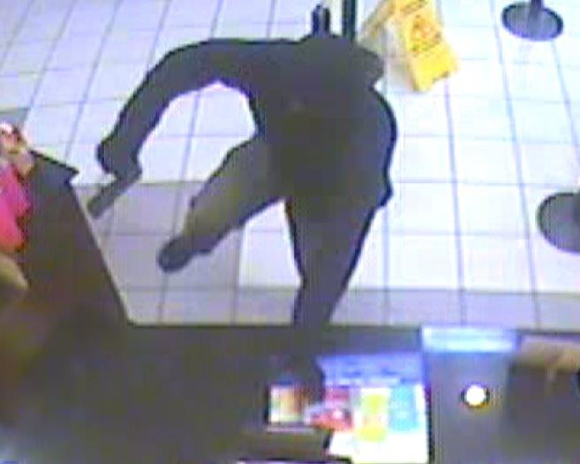
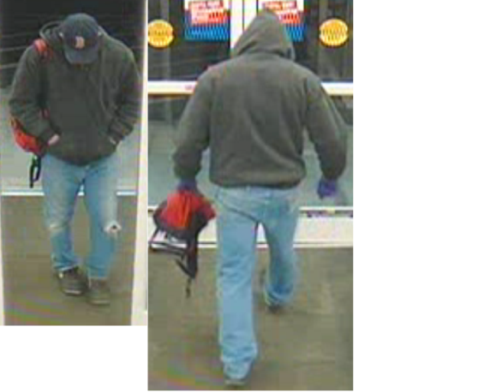
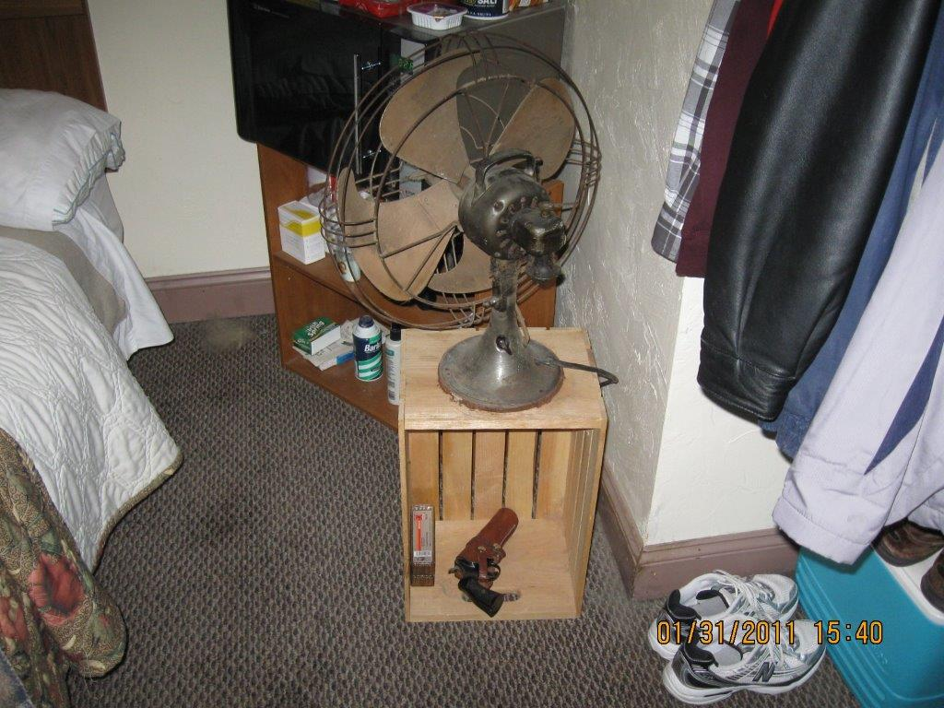
Other Measures
Overdoses
Syringe Retrieval
OUI
Drug Cases Initiated
Warrants of Apprehension
User Referrals
Party Response
Protective Custody
Compliance Checks (Underage Drinking)
Drug Take Back Weight
Prescription Monitoring Program (PMP)

Slide 4
Simply - Why Do
People Use Drugs
Why People Want to Use?
To Feel Good.
To Feel Better.
To Do Better.
Because Others Do.
(NIDA, 2005)
Why People Want to Stop Using?
To Feel Good.
To Feel Better.
To Do Better.
Because Others Do.

Slide 5
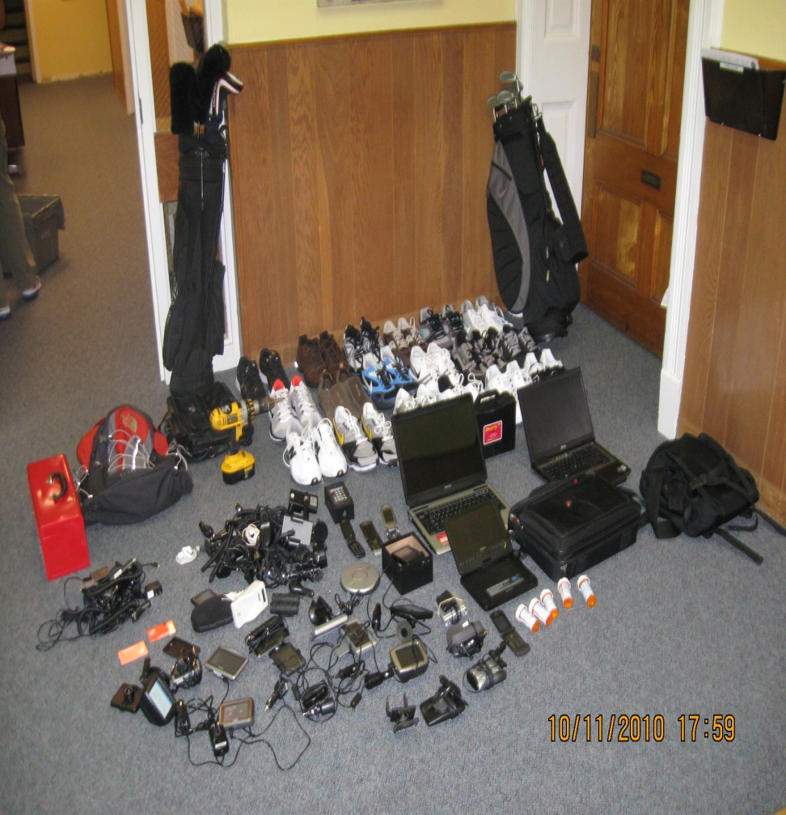
Why People Use Drugs
Biological: People can be born with genetic predispositions (I.E. History of Drug/Alcohol Abuse in family/Addicted babies, etc.
Environmental: Environment may breed influences including peer pressure, physical and/or sexual abuse, stress & quality of parenting or family cohesion.
Developmental: Education, social bonds and biological and/or Environmental factors interacting during crucial developmental stages.

Slide 6
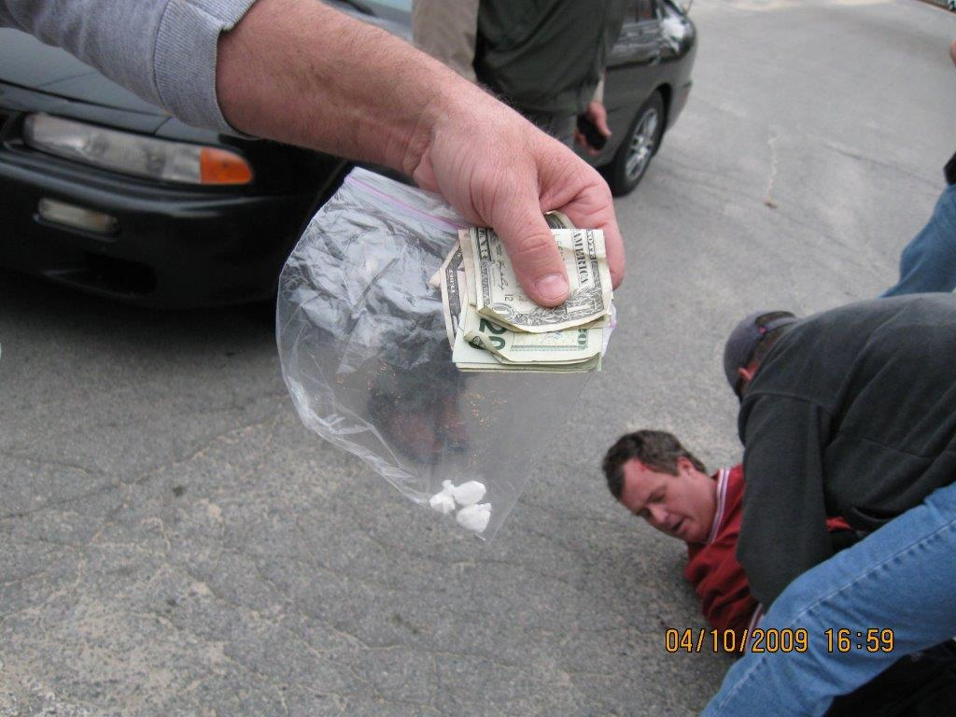
Predictive Risk Factors
Social Control: Lack of strong bonds with family, peers, work, religion, (family cohesion).
Social Learning: Modeling & observation, imitation of substance use, parental attitudes & beliefs.
Stress & Coping: Life stressors; relationships, work, financial (SES), education.
Lack of Coping Mechanisms: Coping avoidance, escape reality, self medication, stress relief.
Behavioral: Lack of alternatives, lack of rewards, lack of positive reinforcement.

Slide 7
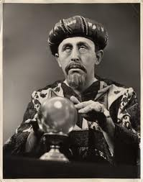
Predictive Factors
Socio-Economic Status
Single Parent Household
Parents who use
Friends/Peers who use
Parents Attitude & Behavior towards use
Societies Attitude & Behavior toward use (Cultural Norms)
Lack of Structure/Discipline
Poor Educational Achievement
Arrested for Use
Early Age of Onset
Poly-Substance Use
Lack Positive Role-Models
Lack Social-Networks
Low Self-Worth/Esteem
Early On-Set

Slide 8
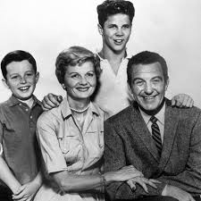
Preventative Barriers
Family Cohesion
Strong Social Networks and Support
Avoiding Peers who Use
Having Parents (Substance Free)
Reducing Negative Role-Models
Increased Self-Esteem
Positive Outlets: Sports, Hobbies, Recreation, Alternatives to Use
Develop Sense of Self-Worth/Acceptance
Assertiveness
Rules & Structure
Education
Delaying Initiation/Age of Onset
Techniques to Avoid Initiation
Prevention
Early Intervention
Enforcement

Slide 9
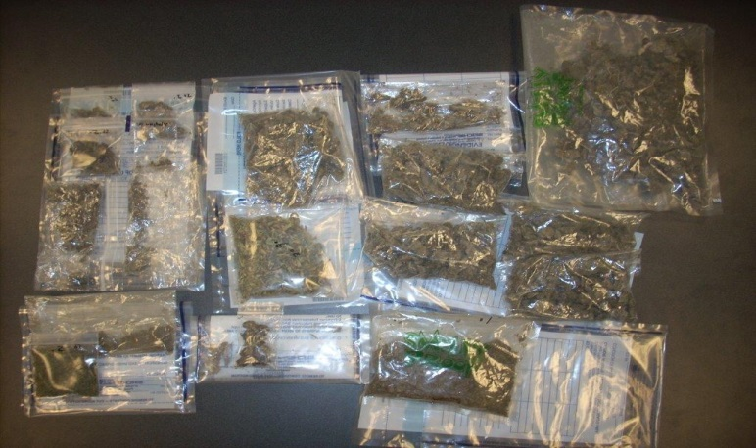
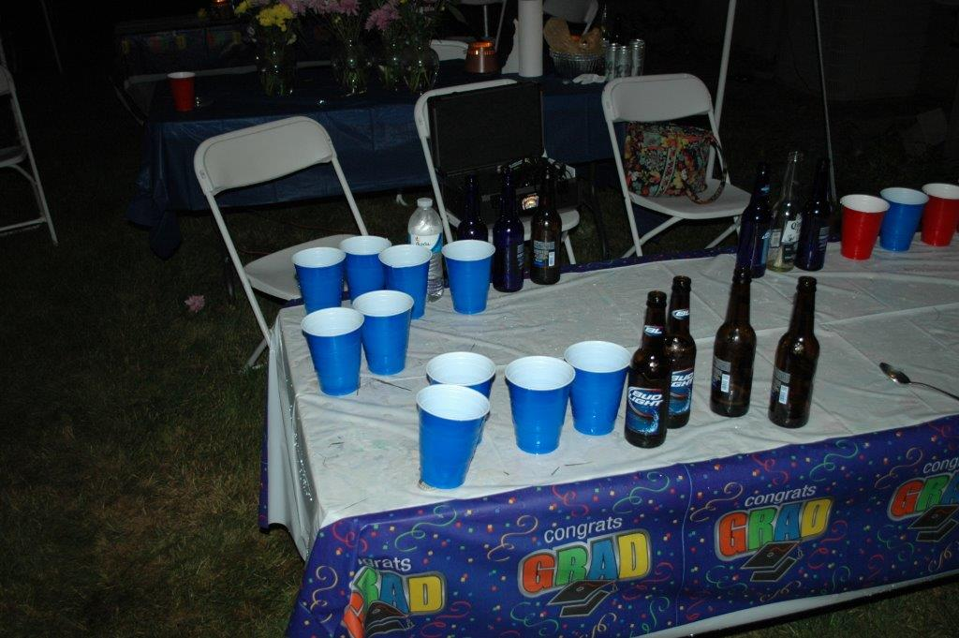
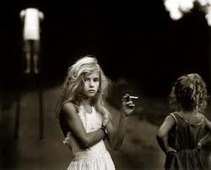
Gateway Drugs
AVAILABILITY, PRICE, RISK play a role:
Tobacco Products
Marijuana
Alcohol
May also be prescription pills, synthetic drugs, huffing etc.
Gateway = No
Causation but age of onset important

Slide 10
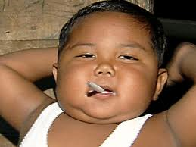
Related Factors
Drug Use Habits, Patterns & Behavior can be developed during adolescents:
Initiation: 11-21 then declines dramatically.
Age of Onset: Important in determining future substance use issues. Earlier age of onset associated with future substance related problems.
Perception of Harm: How harmful or not a drug is perceived. Lower perception of harm associated with more likely use. Marijuana – Molly
Perception of Other Use: Who else is using, the infamous quote “everyone does it!” Less don’t than do!
Adolescent Brain: Not matured until about 25. Critical periods in brain development wherein substances have more profound developmental effects. Pre-frontal cortex associated with weighing pros/cons, impulse control & judgment.
Life Course Persistent vs. Adolescent Limited Behavior: Trajectory through adulthood or not!

Slide 11
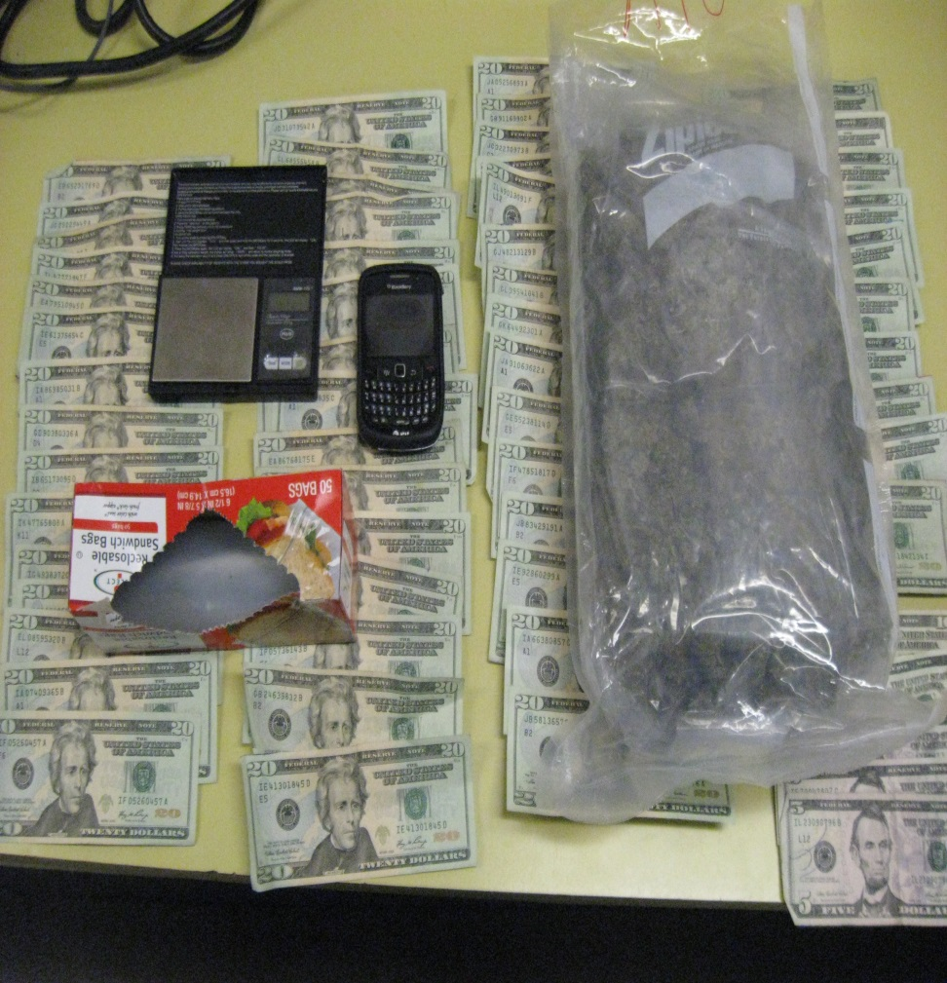
Drug & Alcohol Impact
Public Health = #1 Problem
Financial = 500 Billion annually for (lost productivity, criminal justice, medical costs) $2 per drink (CDC 2011)
Mortality = SUD leading cause of mortality – Alcohol 15-59, opiate overdose leading cause of accidental death
Prevention = Onset during adolescents (risk management)
90% of adults w/dependence onset before 18.
50% of adults start using before 15.

Slide 12
WALPOLE MASSACHUSETTS
Age of Onset Marijuana & Alcohol

Slide 13
Perception of Harm
Perception of Harm - Marijuana

Slide 14
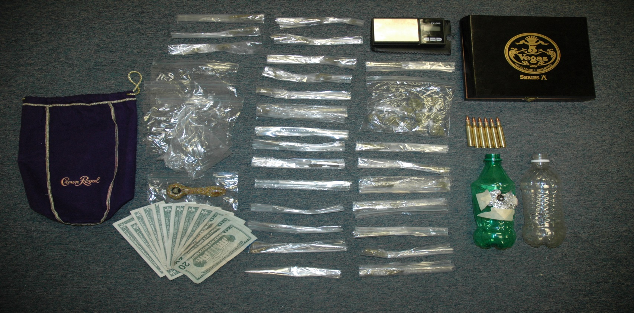
Perception of Other Use

Slide 15
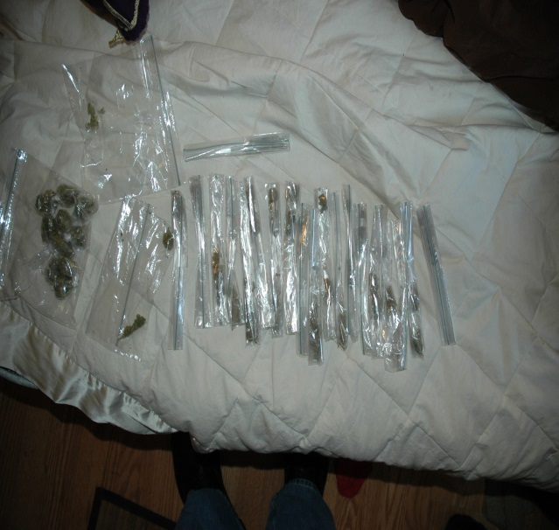
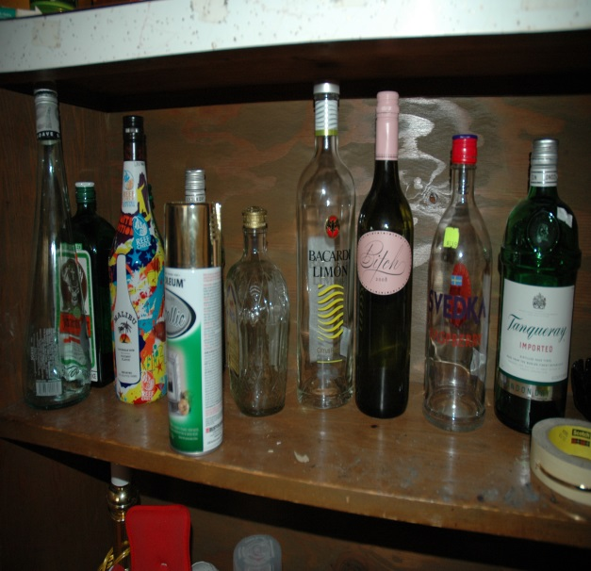
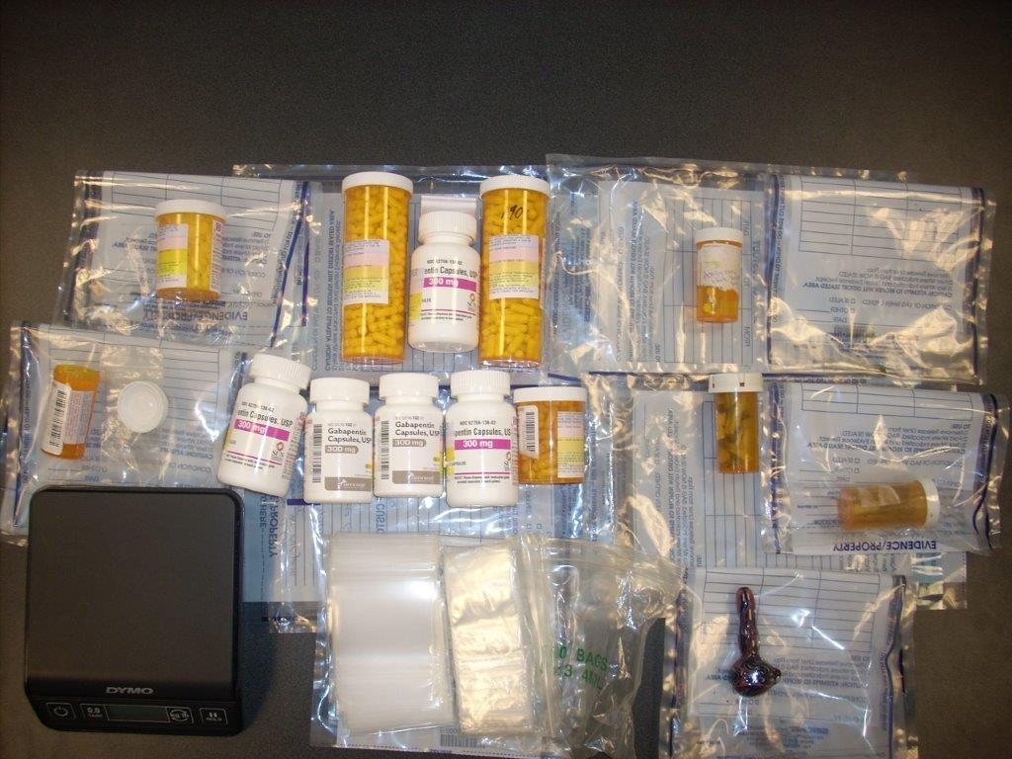
Availability

Slide 16
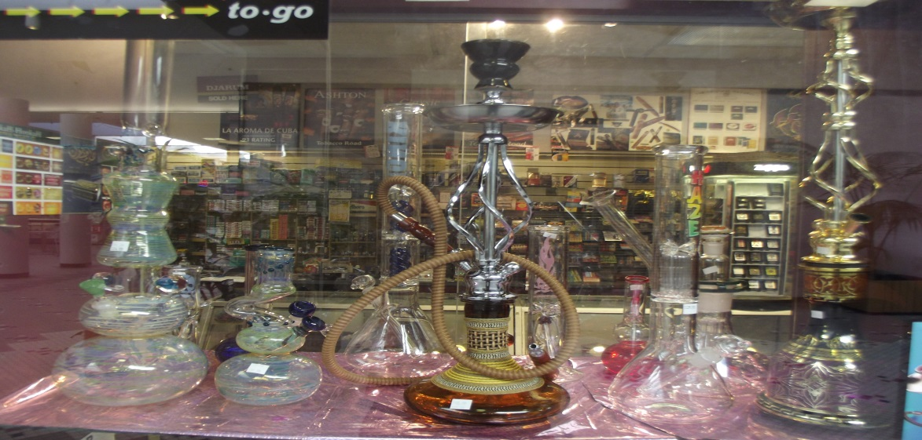
Other Factors Surveyed

Slide 17
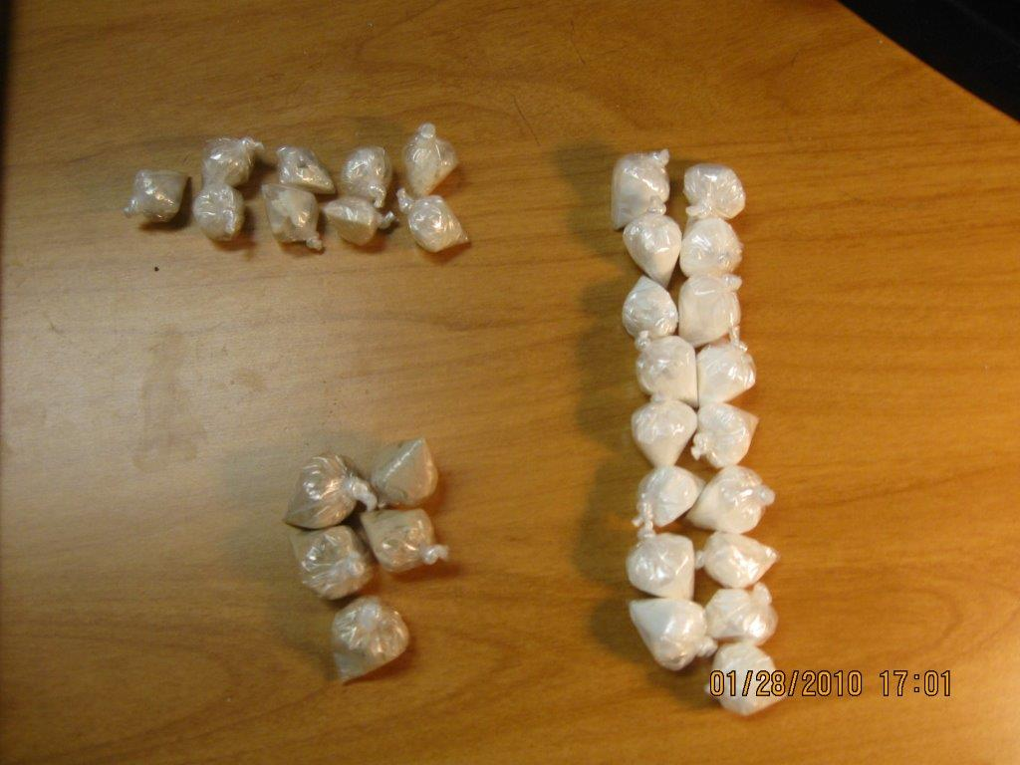
Narcotics (Greek Word = Stupor)
Opioids
Heroin, OxyContin, Vicodin, Codeine, Morphine, Methadone, & Fentanyl
Street Names
Smack, Horse. Mud, Brown, OC, Oxy, 30s, 80s.
Hydro-Morphone – aka: Footballs
Look Like
Tablets, Capsules, patches, powder, chunks.
How Ingested
Swallowed, smoked, sniffed or injected.
Paraphernalia
Pill bottles, hides, syringes, cotton balls, burnt spoons, thick rubber bands, small water bottles, lighter.
Detection
Slow, lethargic, nodding off, euphoria, sedated, uninterested, dilated pupils – pinpoint.
PHYSICAL AND PHSCYOLOGICAL DEPENDENCE

Slide 18

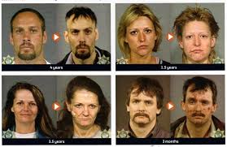
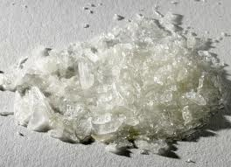
Stimulants
Amphetamines (Ice, speed, uppers, footballs) Used to treat Obesity, Parkinson’s disease, ADHD, & Narcolepsy. Adderall & Ritalin are most abused. (Kids think it will help with school work).
Cocaine (white, coke, blow, dust, nose candy)
Methamphetamine (Ice, Crystal, Meth)

Slide 19
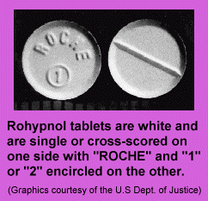
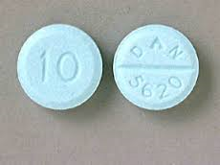
Depressants
Sedative, muscle relaxant, hypnotic, & antidepressant.
Barbiturates
Benzodiazepines - Valium, Librium and Xanax.
Valium/Diazepam Anti-Anxiety in Walpole area.
GHB (Gamma- hydroxybutyrate): Clear liquid, white powder, tablet, and capsule form.
Rohyphnol (Forget me, roofies, rope, date rape drug). Processes quickly w/in 72 hours.
Alcohol

Slide 20
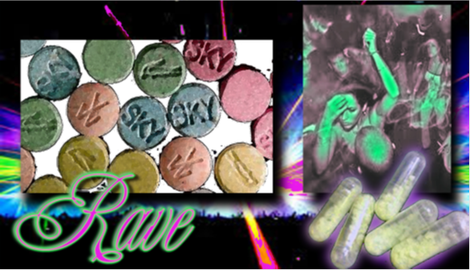
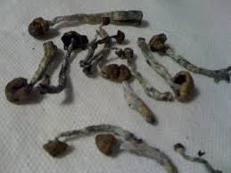
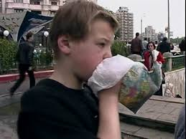
Hallucinogens
MDMA – Ecstasy or Molly (Synthetic)
K2/Spice
LSD
Peyote
Psilocybin (Mushrooms)
Marijuana/Cannabis
Steroids
Inhalants

Slide 21
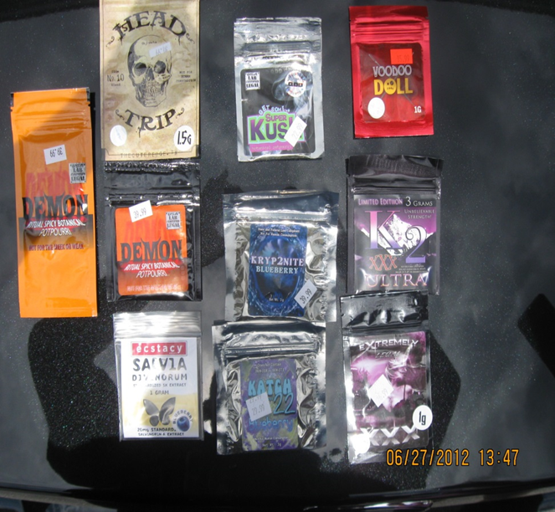
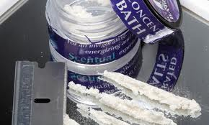
Synthetics
Marijuana
K2, Spice, Skunk.
Sold as Incense, Potpourri etc: Not intended for human consumption.
Usually smoked.
Herbal substances sprayed with chemicals and sold in head-shops, convenient stores, & gas stations.
Anxiety, agitation, hallucinations, nausea, vomiting, seizures.
Cocaine
Vanilla Sky, White Lightening, Ivory Wave, Cloud 9.
Sold as bath salts, plant food, or plant fertilizer.
Violence, paranoia, delusions, hallucinations, nosebleeds, seizures.

Slide 22
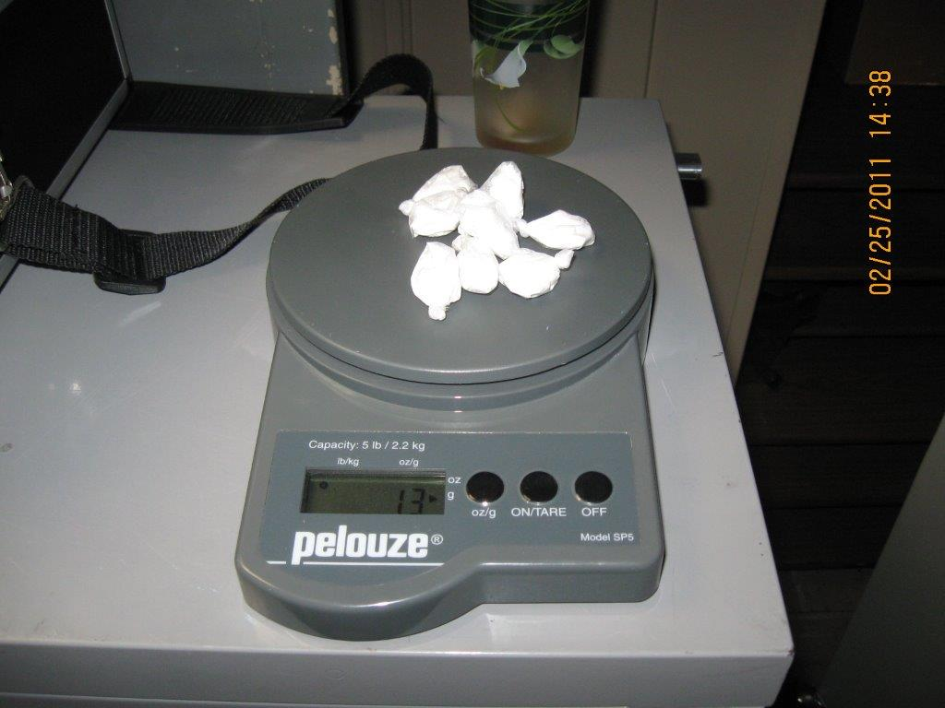
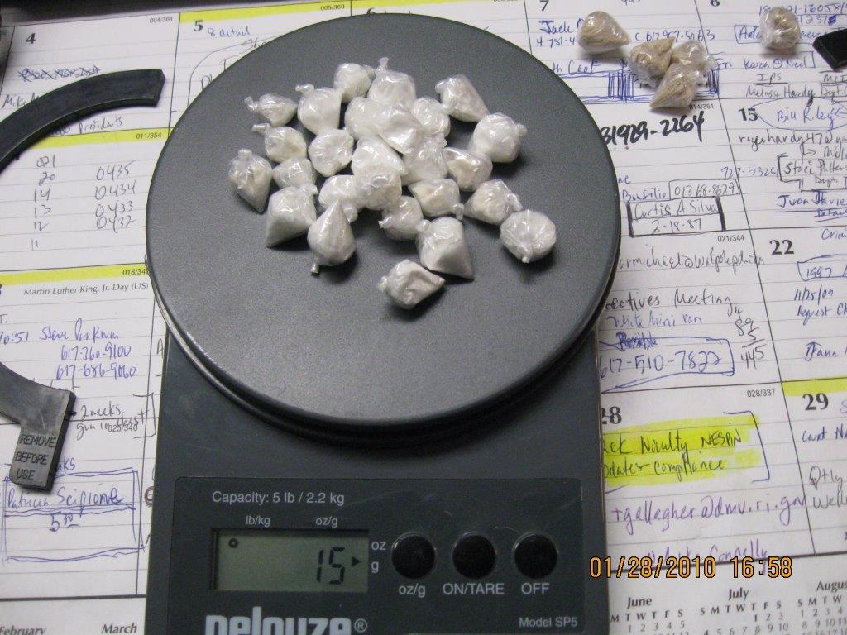
Identification
Cocaine
Heroin

Slide 23
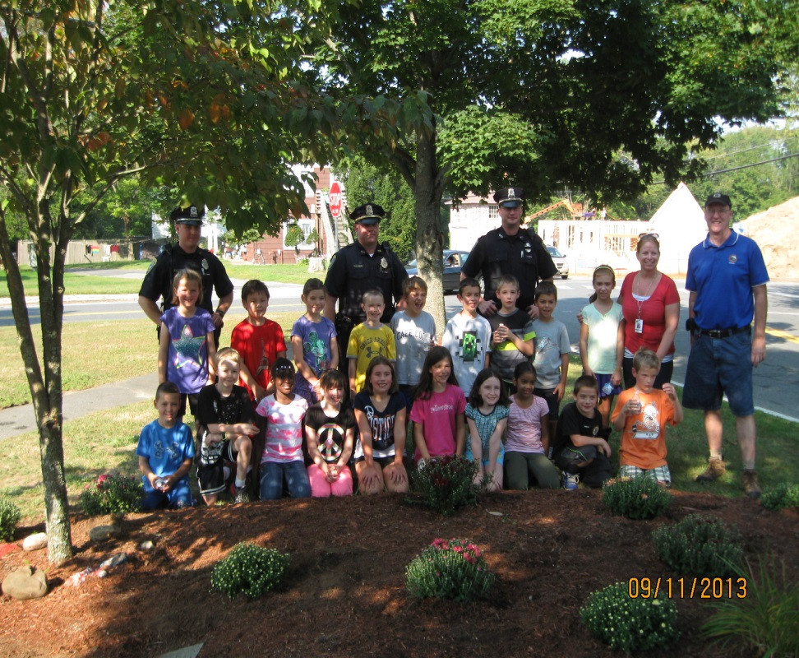
Community Problem
What Can We Do?
Educate parents/guardians of warning signs and predictive factors
Prevention Education and Action
Identify users and refer to early intervention
Educate public and use MGL Ch. 123 Sec 35
Educate on Social Host and alcohol predictive factors
Decrease Availability: Address Supply & Demand through enforcement (task force), drug take back, underage drinking grant, Prescription Monitoring, Naloxone to 1st responders, drug treatment referrals, keep price high.
Mitigate the issues surrounding substance use & abuse
Work together as a community and deal with substance issues as a team.

Slide 24
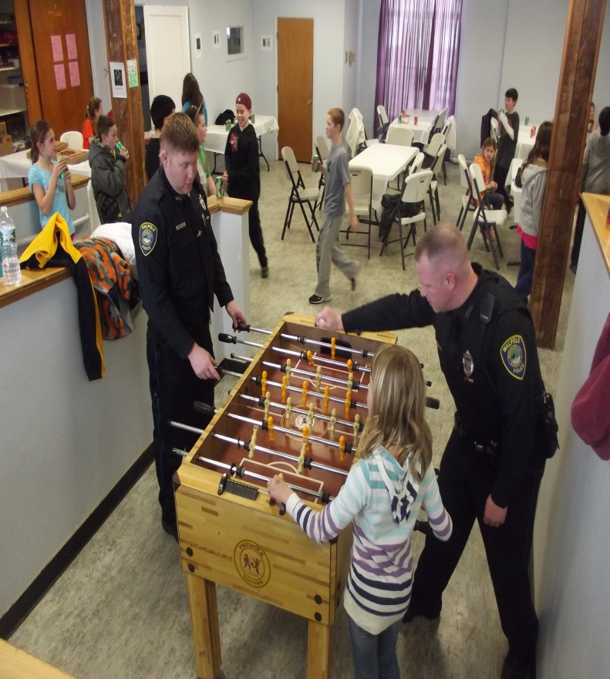
Community Problem
What Can We Do?
Goal = Delay or Prevent On-Set to Substance Use!
Education, Prevention, Enforcement, & Treatment
Create Partnerships with the Community (adolescents).
Recruit Stakeholders
Create programs and alternatives for kids as barrier against initiation
Work to change cultural norms
Identify and Engage At-Risk Youth and work with parents/guardians
Educate youth on consequences, hazards, and statistics to increase perception of harm
Educate youth on misconceptions and provide facts about drugs/alcohol
Provide methods and education to understand initiation and ways to avoid it

Slide 25
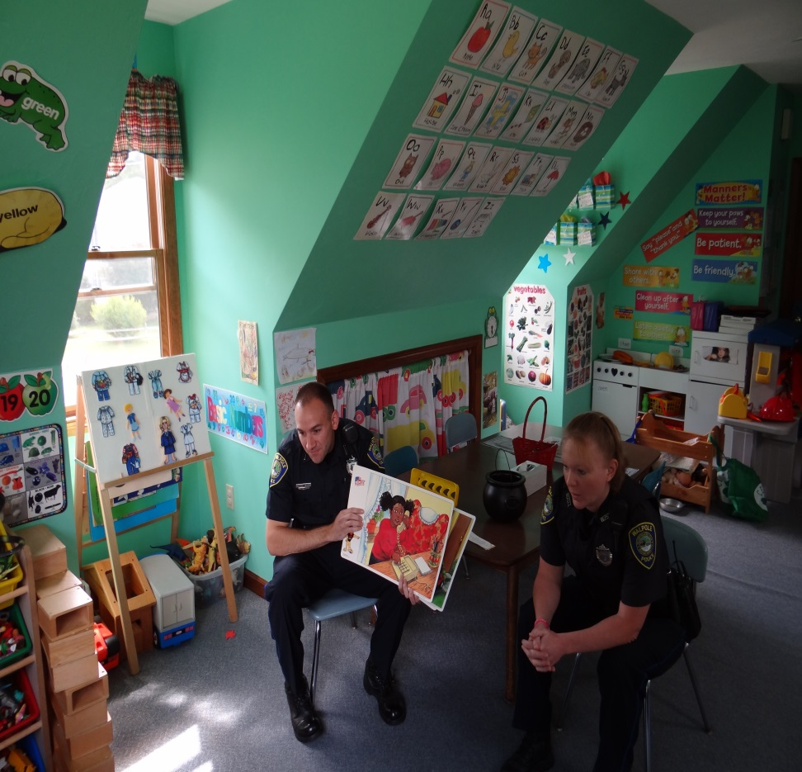
8 Ways to Say No!
Avoid the Situation
Strength in Numbers
Walking Away
Cold Shoulder
Saying “NO”
Giving a Reason or Excuse
Changing the Subject & Offer Alternatives
Repeated Refusal
Use of Humor

Slide 26
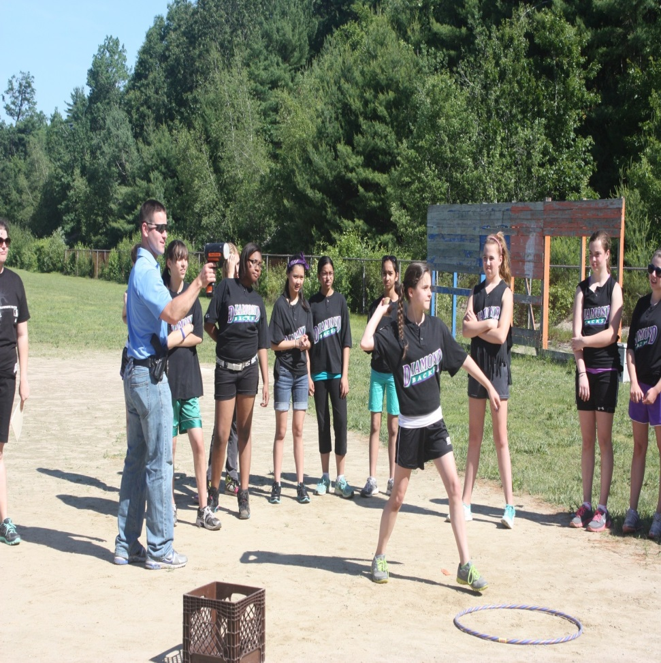
Decision Making Model for Kids
DARE
Define: describe the problem, challenge or opportunity.
Assess: What are your choices and consider the consequences.
Respond: Make a sound choice after gather facts & information
Evaluate: Review your decision and ask if you are making the right choice? Think before you act!

Slide 27

THANK YOU!

